Slide 1
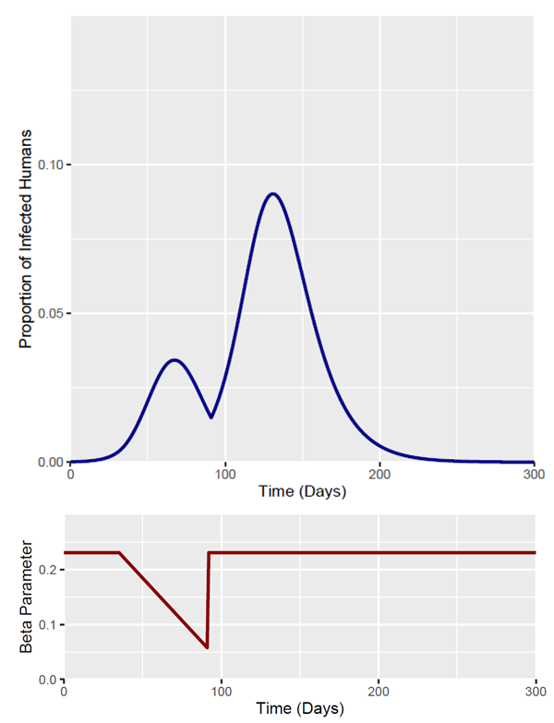
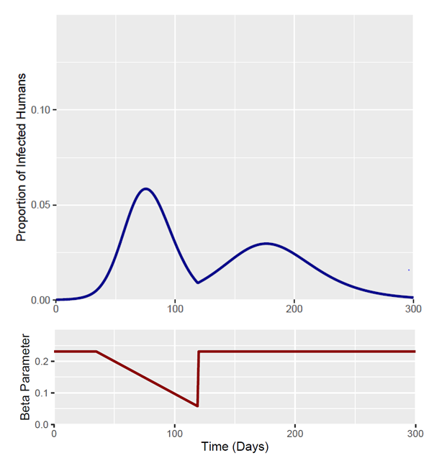
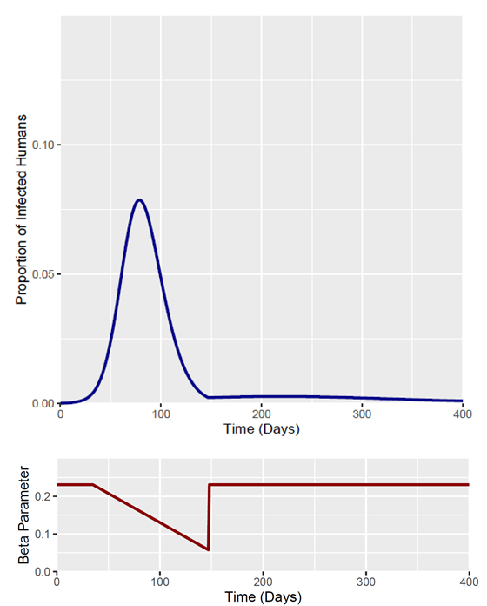
Output Measures | 8 Week Intervention | 12 Week Intervention | 16 Week Intervention
Total Fraction Infected | 0.743 | 0.65 | 0.54
Peak Fraction Infected | 0.0902 | 0.058 | 0.0786
Time of Epidemic Peak | Day 131 | Day 75 | Day 79

Slide 2
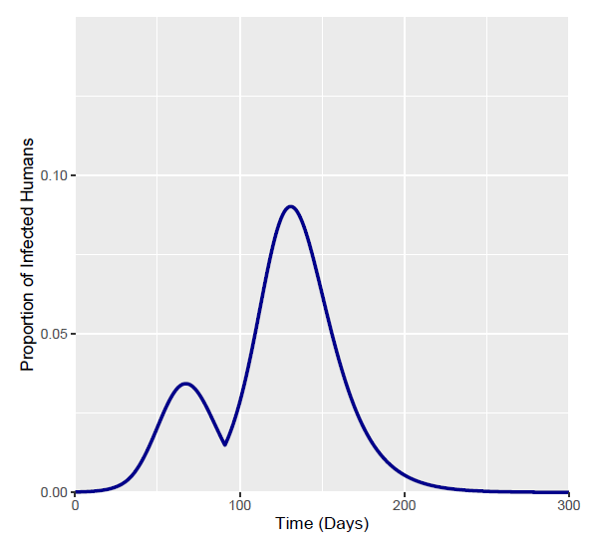
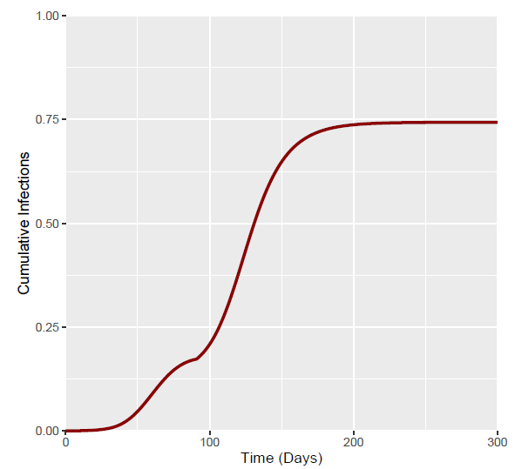
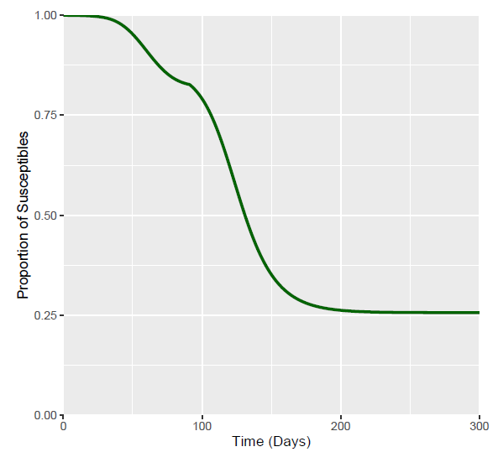
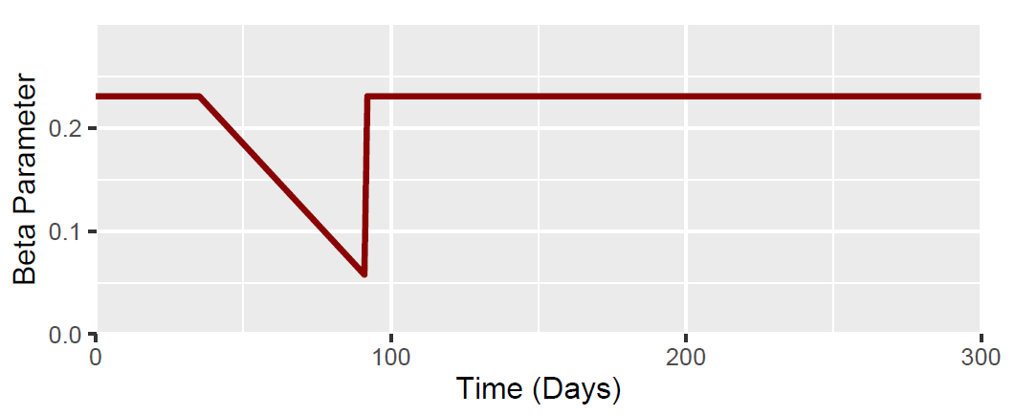
Day 35 (I at 35 Days = 0.0056): Intervention Duration 8 Weeks (56 Days)
Output Measures | Value
Total Fraction Infected | 0.743
Peak Fraction Infected | 0.0902
Time of Epidemic Peak | Day 131

Slide 3
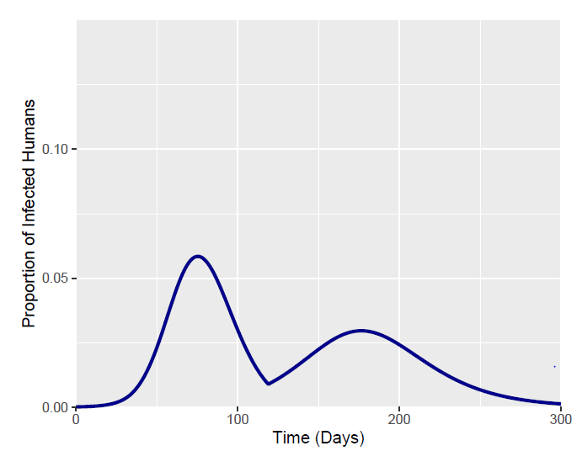
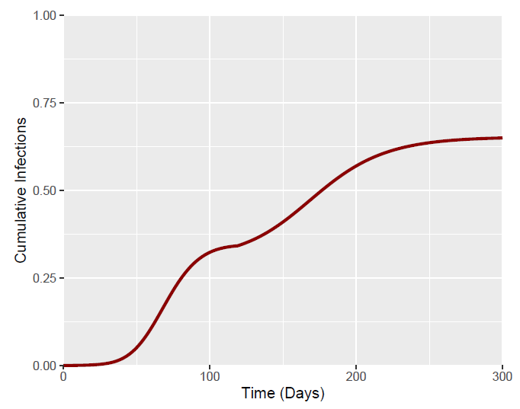
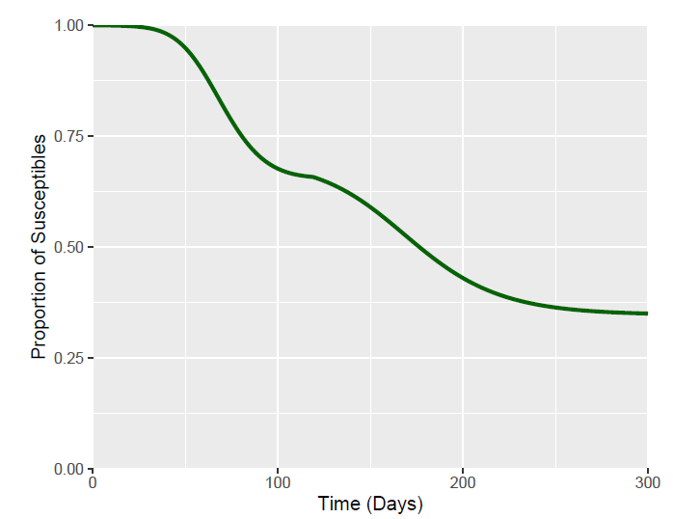
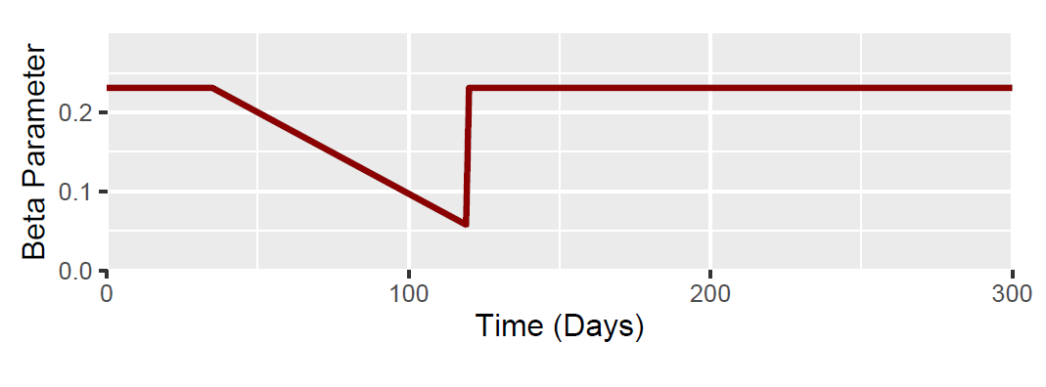
Day 35 (I at 35 Days = 0.0056): Intervention Duration 12 Weeks (81 Days)
Output Measures | Value
Total Fraction Infected | 0.65
Peak Fraction Infected | 0.058
Time of Epidemic Peak | Day 75

Slide 4
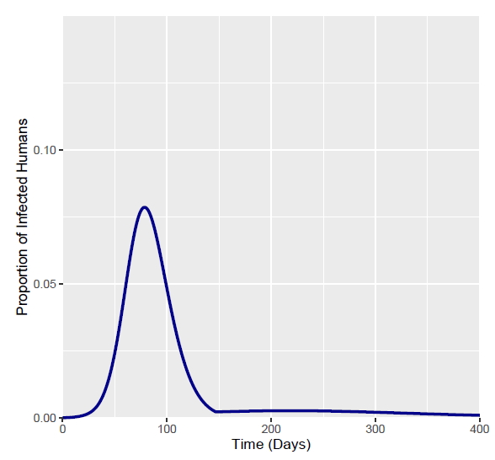
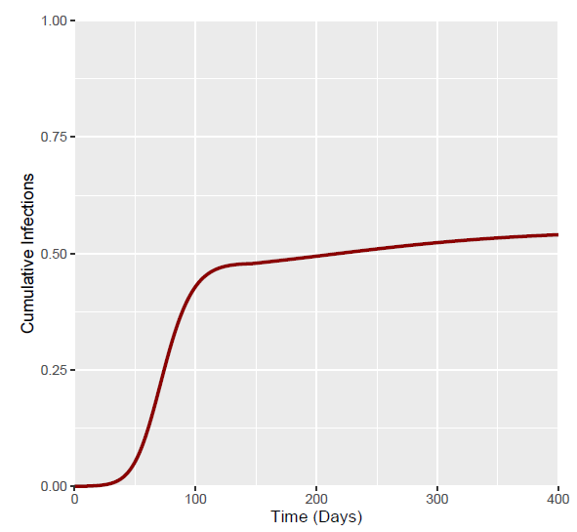
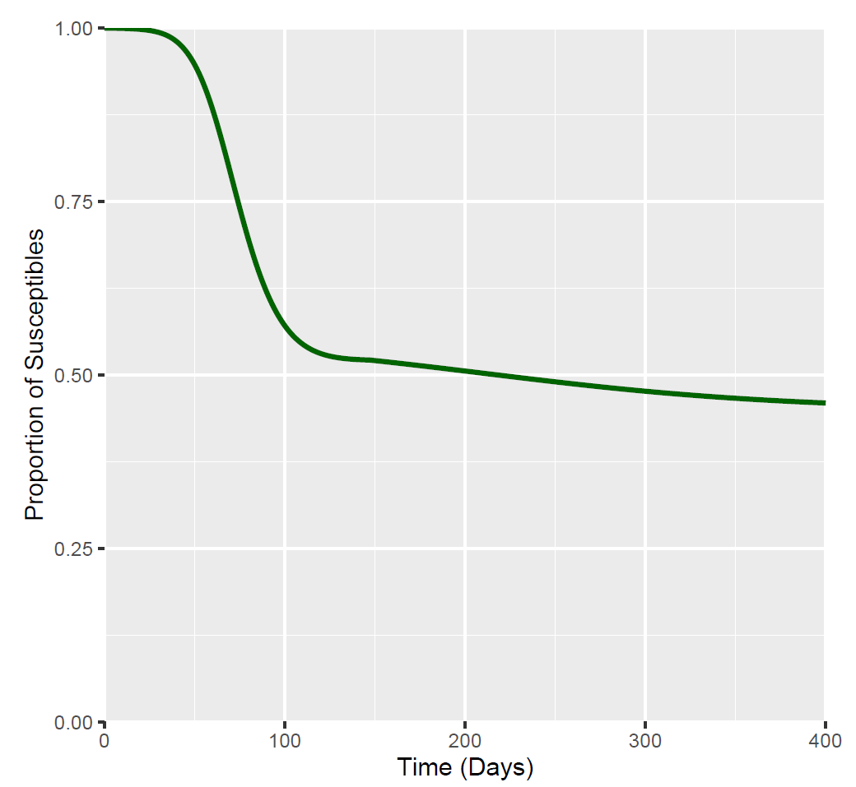
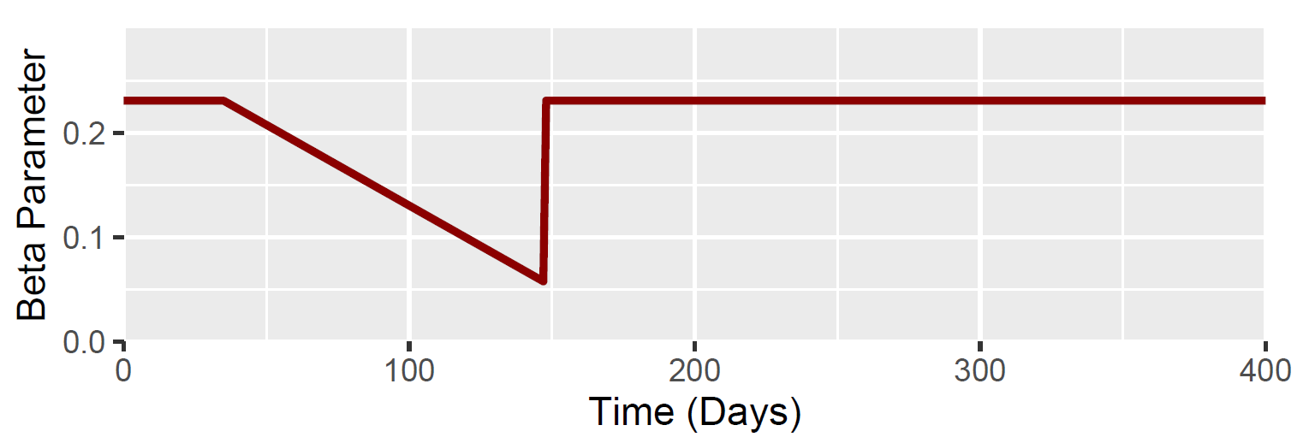
Day 35 (I at 35 Days = 0.0056): Intervention Duration 16 Weeks (112 Days)
Output Measures | Value
Total Fraction Infected | 0.54
Peak Fraction Infected | 0.0786
Time of Epidemic Peak | Day 79

